Slide 1


Slide 2

Implementation of Deep Learning Method for Prediction of Cardiovascular Disease (IDMPCVD)

Slide 3
Group Members Introduction
Zahir Ahmad MC200400105
Sayyada Aleena Bukhari MC190402109

Slide 4

INTRODUCTION OF PROJECT
Build a Deep learning model for the prediction of Cardiovascular Disease
Select Specific type of cardiovascular disease
Choose proper datasets
Preprocess dataset
Features extractions
Build model
Train model
Test model
Tune model

Slide 5
INTRODUCTION OF PROJECT
We used deep learning methods on UCI machine learning repository [3] and Mendeley Data [4] datasets to predict the CAD. For structured or labelled data, we used Artificial Neural Network (ANN), and for unstructured or images dataset we used Convolutional Neural Network the training of model and achieved almost 90% accuracy in disease prediction. We used Streamlit Python Library to take inputs and show results.

Slide 6
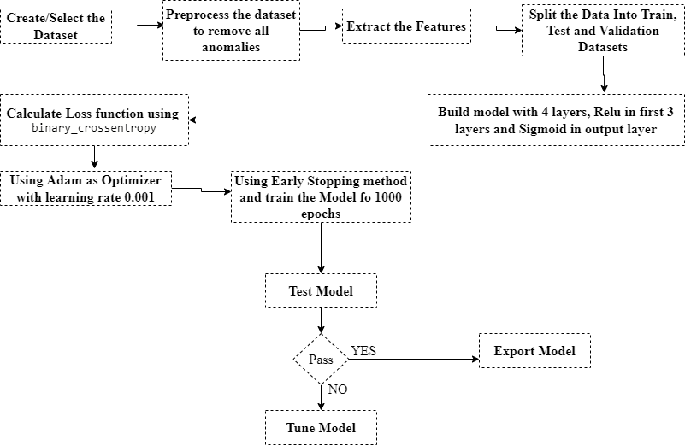
Diagram of Process Model

Slide 7
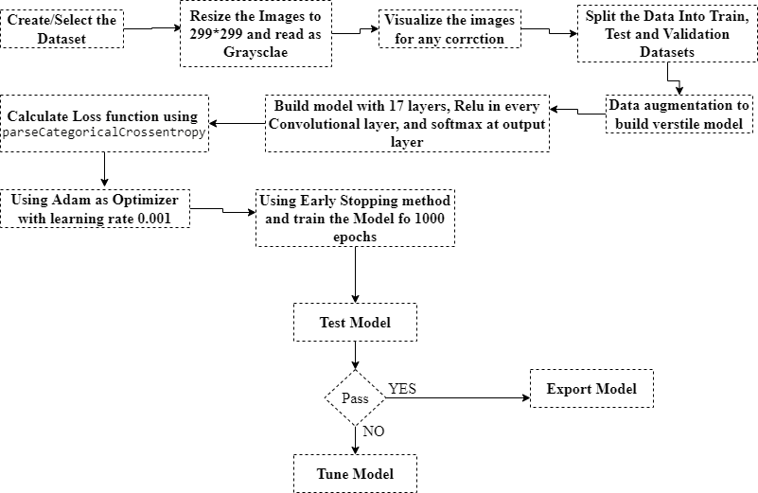
Diagram of Process Model

Slide 8
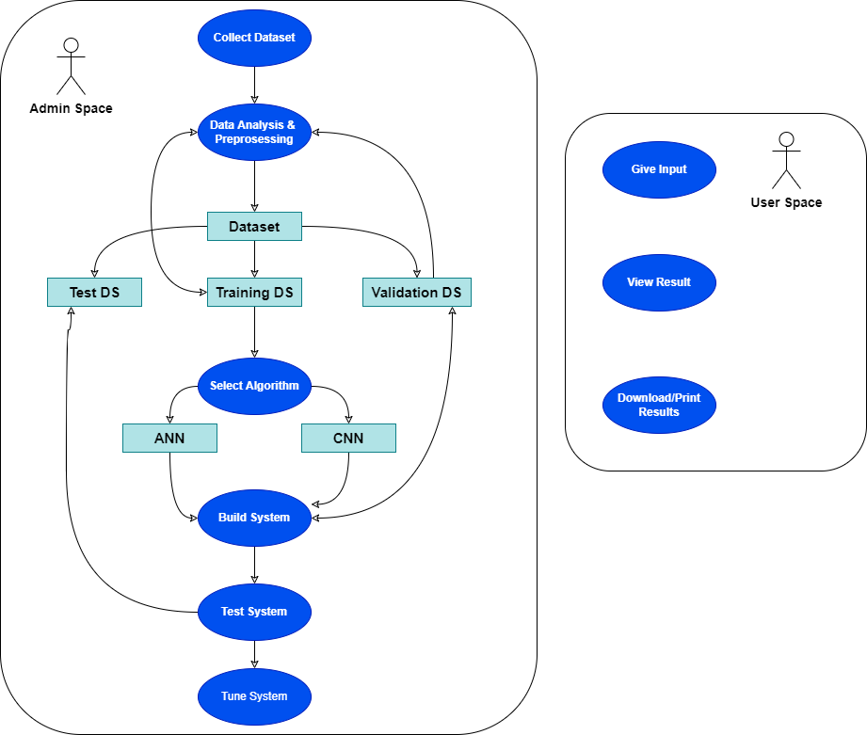
Use Case Diagram

Slide 9
Business Rules Catalog
Functional Requirements
Define the problem and select the dataset as any type of Cardiovascular Disease
Data Analysis and Preprocessing
Feature Extraction
Prediction
Build system
Test System
Tune System
The program should have a knowledge-based system according to select data (Structured or Unstructured data).
The program should have the deep learning algorithm to execute model prediction.
The program should evaluate the performance and update knowledge based on the requirement.

Slide 10
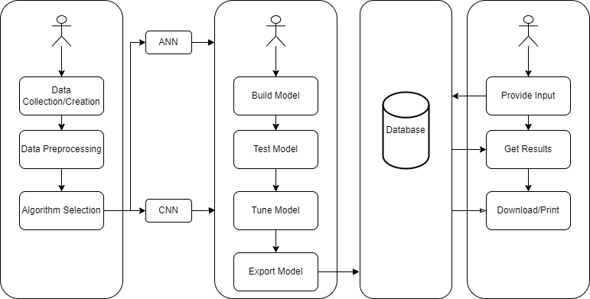
Architectural Design

Slide 11
Team Structure
Both team members works on the project parallelly.

Slide 12
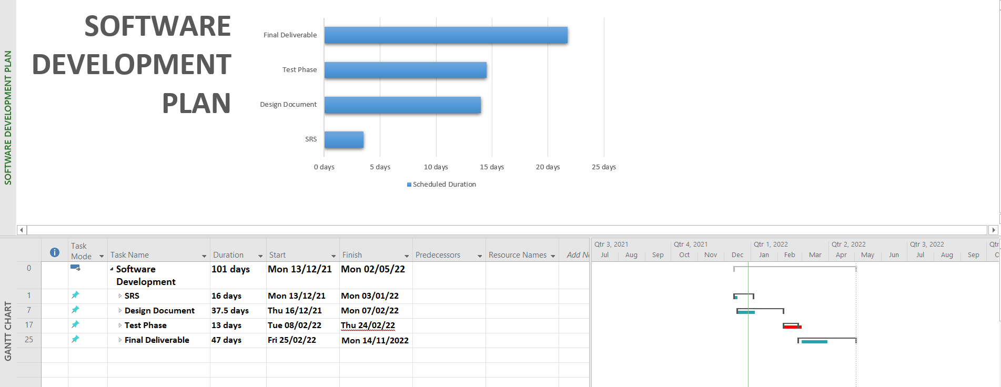
Project Schedule

Slide 13
Sequence Diagrams

Slide 14
Logical Model/Class Diagram

Slide 15
Entity-Relationship Diagram

Slide 16
Database Diagram

Slide 17
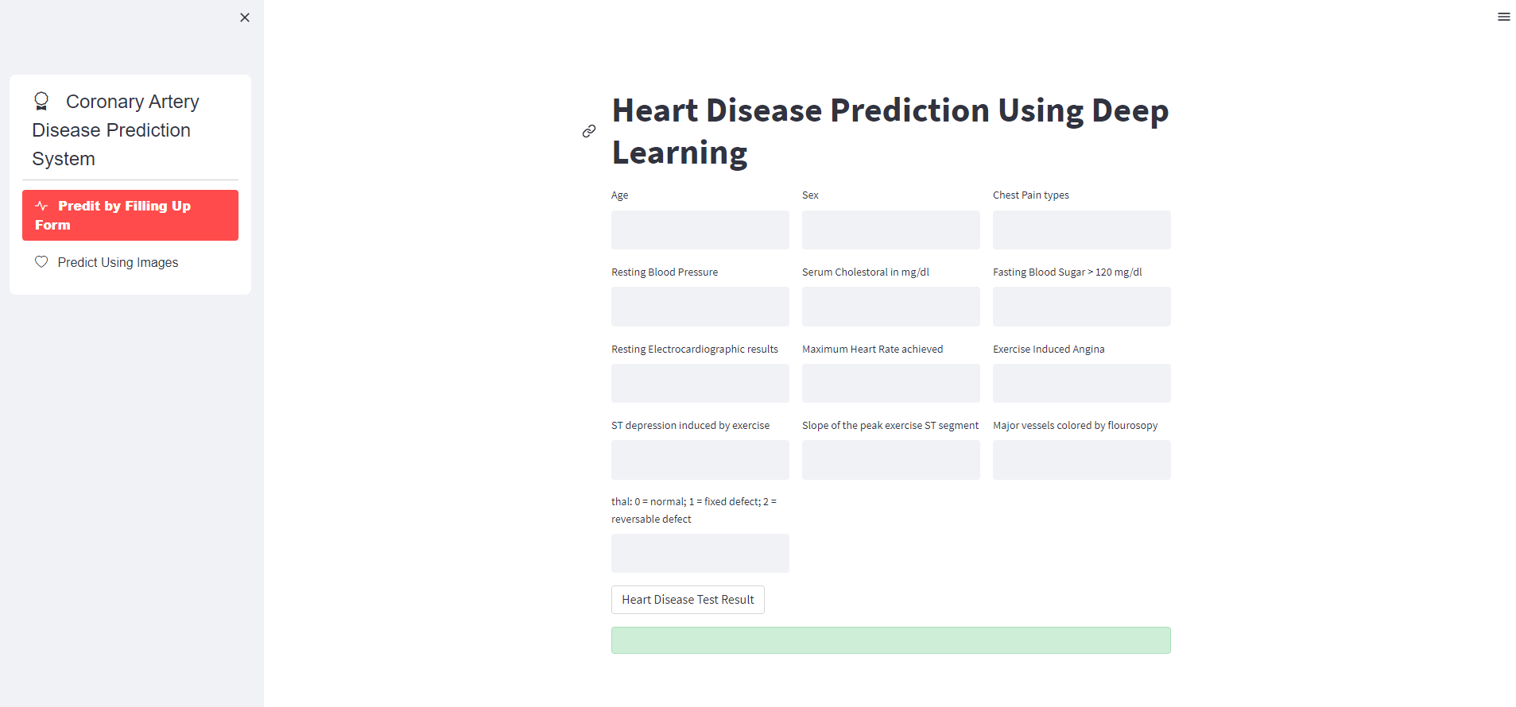
User Interfaces

Slide 18
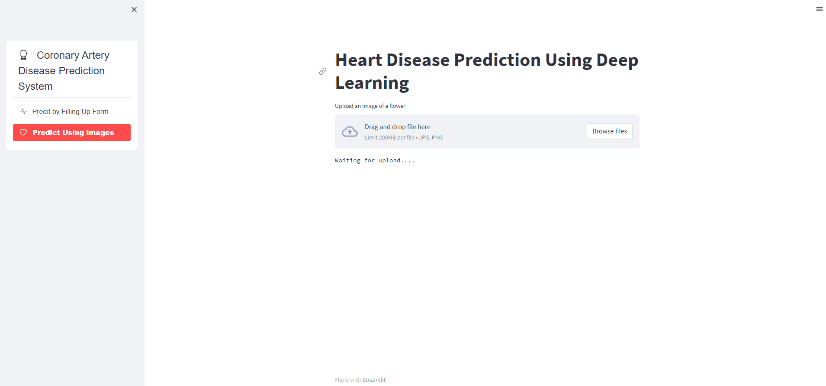
User Interfaces

Slide 19
Tools
Anaconda
Visual Studio Code
Microsoft Visio
Microsoft Project
Draw.io
Google Colab
Streamlit web framework

